Slide 1
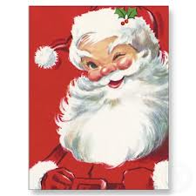
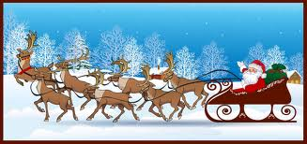
Let’s all….

Slide 2
Let’s celebrate Christmas!!!

Slide 3
Jesus Christ is born…

Slide 4
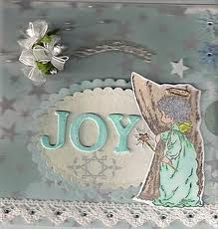
Let’s fill, let’s fill our heart with joy, love and care for all…

Slide 5
Since our heart is happy

Slide 6
we don’t mind

Slide 7
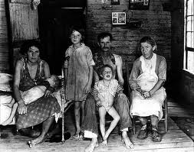
if our clothes are worn

Slide 8
Since we are all together

Slide 9
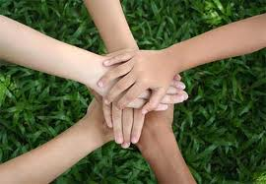
keep in mind that you are not alone…

Slide 10
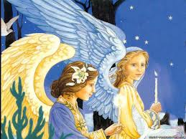
Years ago in Bethleem land Angels told the World

Slide 11
that the real King of us came to save us all!!!

Slide 12
Give your hand and share love

Slide 13
Smile to me a bit…

Slide 14
We are young

Slide 15
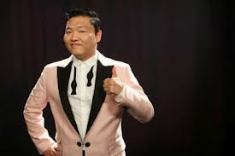
“Nothing can change that”

Slide 16
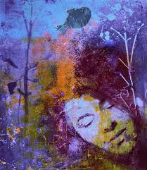
Let us live the dream!!!

Slide 17
Let’s all, let’s celebrate Christmas

Slide 18
Jesus Christ is born…

Slide 19
Let’s fill, let’s fill our heart with joy, love and care for all…

Slide 20
3rd High School of Kozani

